Slide 1



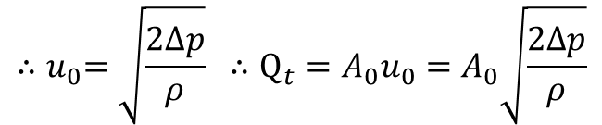







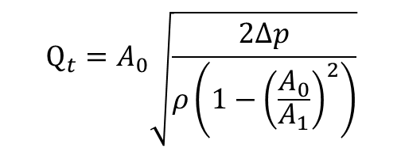

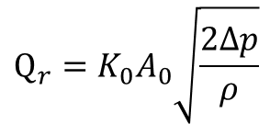

$$u_{1}$$
$$D_{0}$$
$$u_{0}$$
$$\frac{u}{u_{max}}={\left(1−\frac{r}{R}\right)}^{1/n}$$
$p_{1}+ρ\frac{{u_{1}}^{2}}{2}$ = $p_{0}+ρ\frac{{u_{0}}^{2}}{2}$
$$m={(23.2/30)}^{2}=0.598$$
$$p_{1} \text{−} p_{0}=ρ\frac{{u_{0}}^{2}}{2}=∆p$$
${{(u}_{0}}^{2}{>>u_{1}}^{2}$)
$$K_{0}=f\left({Re}_{D_{1}},m \right)$$
$$Q_{t}=A_{0}\sqrt{\frac{2∆p}{ρ\left(1−{\left(\frac{A_{0}}{A_{1}}\right)}^{2}\right)}}$$
$${∴u}_{0}=\sqrt{\frac{2∆p}{ρ}} ∴Q_{t}=A_{0}u_{0}=A_{0}\sqrt{\frac{2∆p}{ρ}}$$
$${Re}_{T}={10}^{4185+2831m−1438m^{2}}$$
$$\left({Re}_{D}≥{Re}_{T}\right)$$
$$Q_{r}=K_{0}A_{0}\sqrt{\frac{2∆p}{ρ}}$$
$K_{0}$= $0.597−0.011m+0.432m^{2}$

Slide 2



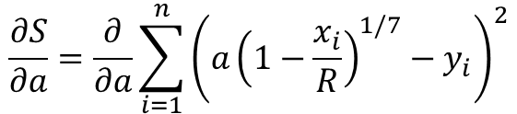
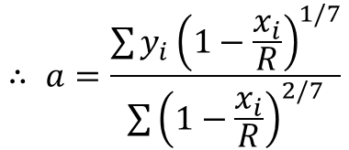
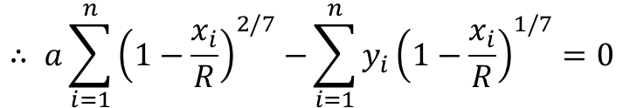
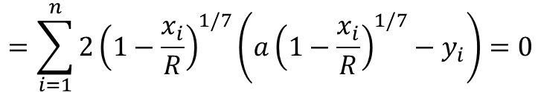
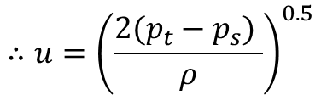
$$\left(a=u_{max} , y=u , r=x\right)$$
$$\frac{∂S}{∂a}=\frac{∂}{∂a}\sum_{i=1}^{n}{{\left(a{\left(1−\frac{x_{i}}{R}\right)}^{1/7}−y_{i}\right)}^{2}}$$
$$=\sum_{i=1}^{n}{2{\left(1−\frac{x_{i}}{R}\right)}^{1/7}\left(a{\left(1−\frac{x_{i}}{R}\right)}^{1/7}−y_{i}\right)=0}$$
$$u={u_{max}\left(1−\frac{r}{R}\right)}^{1/7}$$
$$∴ a\sum_{i=1}^{n}{{\left(1−\frac{x_{i}}{R}\right)}^{2/7}−}\sum_{i=1}^{n}{{y_{i}\left(1−\frac{x_{i}}{R}\right)}^{1/7}}=0$$
$$∴ a=\frac{\sum{{y_{i}\left(1−\frac{x_{i}}{R}\right)}^{1/7}}}{\sum{{\left(1−\frac{x_{i}}{R}\right)}^{2/7}}}$$
$$p_{t}=p_{s}+\frac{ρu^{2}}{2}$$
$$∴u={\left(\frac{2({p_{t}−p}_{s}) }{ρ}\right)}^{0.5}$$

Slide 3
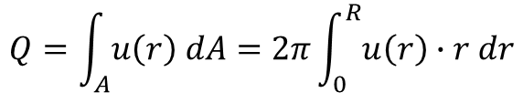















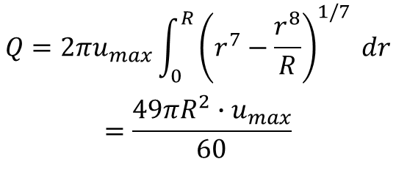





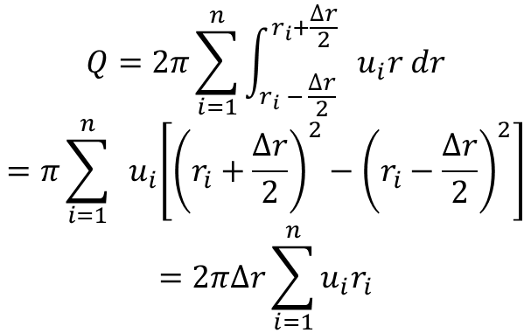




$$Q=\int_{A}^{ }{u\left(r\right) dA}=2π\int_{0}^{R}{u\left(r\right)∙r dr}$$
$$R$$
$$r_{5}$$
$$u_{5}$$
$$∆r$$
$$Q=2π\sum_{i=1}^{n}{\int_{r_{i} − \frac{∆r}{2}}^{r_{i}+\frac{∆r}{2}}{{ u}_{i}r dr}}$$
$$=π\sum_{i=1}^{n}{{ u}_{i}\left[{\left(r_{i}+\frac{∆r}{2}\right)}^{2}−{\left(r_{i}−\frac{∆r}{2}\right)}^{2}\right]}$$
$$=2π∆r\sum_{i=1}^{n}{u_{i}r_{i}}$$
$$r_{4}$$
$$u_{4}$$
$$r_{3}$$
$$u_{3}$$
$$r_{2}$$
$$u_{2}$$
$$r_{1}$$
$$u_{1}$$
$$R$$
$$r_{5}$$
$$u_{5}$$
$$u={u_{max}\left(1−\frac{r}{R}\right)}^{1/7}$$
$$r_{4}$$
$$u_{4}$$
$$Q=2πu_{max}\int_{0}^{R}{\begin{aligned}{\left(r^{7}−\frac{r^{8}}{R}\right)}^{1/7} dr \\ \end{aligned}}$$
$$=\frac{49πR^{2}∙u_{max}}{60}$$
$$r_{3}$$
$$u_{3}$$
$$r_{2}$$
$$u_{2}$$
$$r_{1}$$
$$u_{1}$$

